Slide 2
Основы Maven
2. Сборка

Slide 3
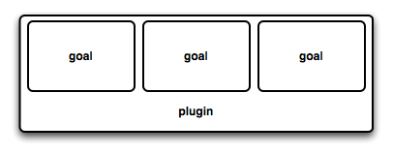

Задачи и плагины
 | Плагин – программный модуль используемый Maven для выполнения действий над проектом. Плагин является артефактом и у него есть координаты. Плагины хранятся в репозиториях плагинов которые как правило совпадают с репозиториями артефактов.
 | Задача – единица работы над проектом (действие) которое плагин может выполнить. Плагин может содержать несколько задач.

Slide 4
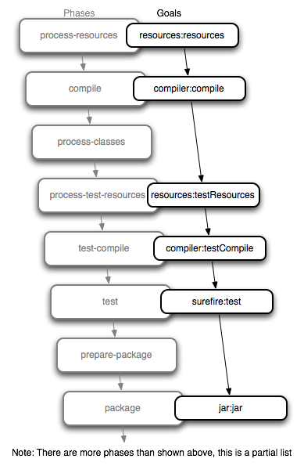

Сборка проекта
 | Собрать проект - пройти через определённую последовательность фаз и для каждой фазы выполнить задачи зарегистрированные у этой фазы.

Slide 5
Основные задачи

Slide 6
Задача resources:resources
I:\project>mvn resources:resources
[INFO] Scanning for projects...
[INFO] Searching repository for plugin with prefix: 'resources'.
[INFO] ------------------------------------------------------------------------
[INFO] Building calculator
[INFO] task-segment: [resources:resources]
[INFO] ------------------------------------------------------------------------
[INFO] [resources:resources {execution: default-cli}]
[INFO] Using 'UTF-8' encoding to copy filtered resources.
[INFO] Copying 1 resource
[INFO] ------------------------------------------------------------------------
[INFO] BUILD SUCCESSFUL
[INFO] ------------------------------------------------------------------------
[INFO] Total time: < 1 second
[INFO] Finished at: Tue Jun 18 14:27:01 GMT+07:00 2013
[INFO] Final Memory: 5M/15M
[INFO] ------------------------------------------------------------------------
I:\project>
[INFO] Copying 1 resource

Slide 7
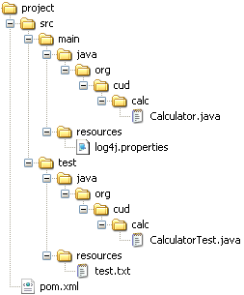
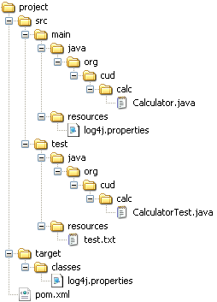
Задача resources:resources

Slide 8
Задача compiler:compile
I:\project>mvn compiler:compile
[INFO] Scanning for projects...
[INFO] ------------------------------------------------------------------------
[INFO] Building calculator
[INFO] task-segment: [compiler:compile]
[INFO] ------------------------------------------------------------------------
[INFO] [compiler:compile {execution: default-cli}]
[INFO] Compiling 1 source file to I:\project\target\classes
[INFO] ------------------------------------------------------------------------
[INFO] BUILD SUCCESSFUL
[INFO] ------------------------------------------------------------------------
[INFO] Total time: < 1 second
[INFO] Finished at: Tue Jun 18 14:34:07 GMT+07:00 2013
[INFO] Final Memory: 5M/15M
[INFO] ------------------------------------------------------------------------
I:\project>
[INFO] Compiling 1 source file to I:\project\target\classes

Slide 9
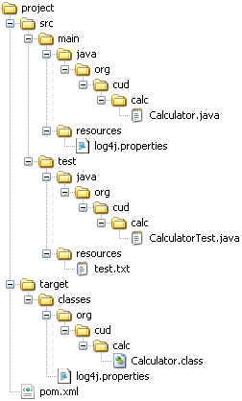
Задача compiler:compile

Slide 10
Задача resources:testResources
I:\project>mvn resources:testResources
[INFO] Scanning for projects...
[INFO] Searching repository for plugin with prefix: 'resources'.
[INFO] ------------------------------------------------------------------------
[INFO] Building calculator
[INFO] task-segment: [resources:testResources]
[INFO] ------------------------------------------------------------------------
[INFO] [resources:testResources {execution: default-cli}]
[INFO] Using 'UTF-8' encoding to copy filtered resources.
[INFO] Copying 1 resource
[INFO] ------------------------------------------------------------------------
[INFO] BUILD SUCCESSFUL
[INFO] ------------------------------------------------------------------------
[INFO] Total time: < 1 second
[INFO] Finished at: Tue Jun 18 14:38:06 GMT+07:00 2013
[INFO] Final Memory: 5M/15M
[INFO] ------------------------------------------------------------------------
I:\project>
[INFO] Copying 1 resource

Slide 11
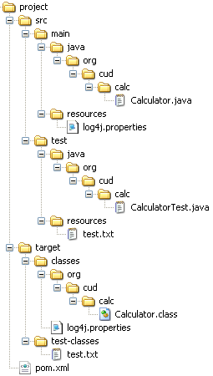
Задача resources:testResources

Slide 12
Задача compiler:testCompile
I:\project>mvn compiler:testCompile
[INFO] Scanning for projects...
[INFO] ------------------------------------------------------------------------
[INFO] Building calculator
[INFO] task-segment: [compiler:testCompile]
[INFO] ------------------------------------------------------------------------
[INFO] [compiler:testCompile {execution: default-cli}]
[INFO] Compiling 1 source file to I:\project\target\test-classes
[INFO] ------------------------------------------------------------------------
[INFO] BUILD SUCCESSFUL
[INFO] ------------------------------------------------------------------------
[INFO] Total time: < 1 second
[INFO] Finished at: Tue Jun 18 14:41:38 GMT+07:00 2013
[INFO] Final Memory: 5M/15M
[INFO] ------------------------------------------------------------------------
I:\project>
[INFO] Compiling 1 source file to I:\project\target\test-classes

Slide 13
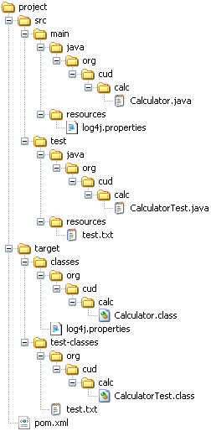
Задача compiler:testCompile

Slide 14
Задача surefire:test
I:\project>mvn surefire:test
[INFO] Scanning for projects...
[INFO] Searching repository for plugin with prefix: 'surefire'.
[INFO] ------------------------------------------------------------------------
[INFO] Building calculator
[INFO] task-segment: [surefire:test]
[INFO] ------------------------------------------------------------------------
[INFO] [surefire:test {execution: default-cli}]
[INFO] Surefire report directory: I:\project\target\surefire-reports
-------------------------------------------------------
T E S T S
-------------------------------------------------------
Running org.cud.calc.CalculatorTest
0 INFO Calculator - Performing summation of [2, 3, 4]
0 INFO Calculator - Performing summation of []
0 INFO Calculator - Performing summation of [23]
0 INFO Calculator - Performing summation of [0, 0, 0, 0, 0]
Tests run: 1, Failures: 0, Errors: 0, Skipped: 0, Time elapsed: 0.078 sec
Results :
Tests run: 1, Failures: 0, Errors: 0, Skipped: 0
[INFO] ------------------------------------------------------------------------
[INFO] BUILD SUCCESSFUL
[INFO] ------------------------------------------------------------------------
[INFO] Total time: 1 second
[INFO] Finished at: Tue Jun 18 14:44:21 GMT+07:00 2013
[INFO] Final Memory: 5M/15M
[INFO] ------------------------------------------------------------------------
I:\project>
Running org.cud.calc.CalculatorTest

Slide 15
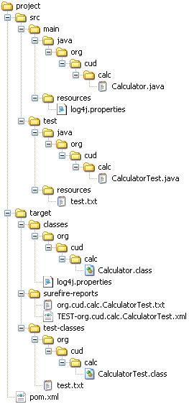
Задача surefire:test

Slide 16
Задача jar:jar
I:\project>mvn jar:jar
[INFO] Scanning for projects...
[INFO] Searching repository for plugin with prefix: 'jar'.
[INFO] ------------------------------------------------------------------------
[INFO] Building calculator
[INFO] task-segment: [jar:jar]
[INFO] ------------------------------------------------------------------------
[INFO] [jar:jar {execution: default-cli}]
[INFO] Building jar: I:\project\target\calculator-0.0.1.jar
[INFO] ------------------------------------------------------------------------
[INFO] BUILD SUCCESSFUL
[INFO] ------------------------------------------------------------------------
[INFO] Total time: < 1 second
[INFO] Finished at: Tue Jun 18 14:47:38 GMT+07:00 2013
[INFO] Final Memory: 4M/15M
[INFO] ------------------------------------------------------------------------
I:\project>
[INFO] Building jar: I:\project\target\calculator-0.0.1.jar

Slide 17
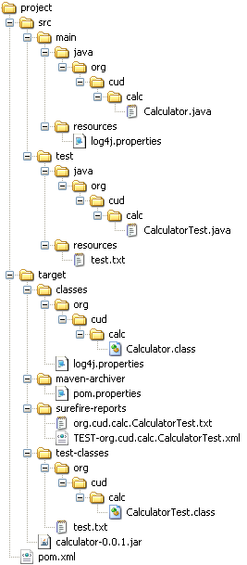
Задача jar:jar

Slide 18
Задача install:install
I:\project>mvn install:install-file -Dfile=target\calculator-0.0.1.jar -DpomFile=pom.xml
[INFO] Scanning for projects...
[INFO] Searching repository for plugin with prefix: 'install'.
[INFO] ------------------------------------------------------------------------
[INFO] Building calculator
[INFO] task-segment: [install:install-file] (aggregator-style)
[INFO] ------------------------------------------------------------------------
[INFO] [install:install-file {execution: default-cli}]
[INFO] Installing I:\project\target\calculator-0.0.1.jar to C:\Documents and Settings\Administrator\.m2\repository\org\cud\mcourse\calculator\0.0.1\calculator-0.0.1.jar
[INFO] Installing I:\project\pom.xml to C:\Documents and Settings\Administrator\.m2\repository\org\cud\mcourse\calculator\0.0.1\calculator-0.0.1.pom
[INFO] ------------------------------------------------------------------------
[INFO] BUILD SUCCESSFUL
[INFO] ------------------------------------------------------------------------
[INFO] Total time: < 1 second
[INFO] Finished at: Tue Jun 18 14:52:25 GMT+07:00 2013
[INFO] Final Memory: 3M/15M
[INFO] ------------------------------------------------------------------------
I:\project>
[INFO] Installing I:\project\target\calculator-0.0.1.jar to C:\Documents and Settings\Administrator\.m2\repository\org\cud\mcourse\calculator\0.0.1\calculator-0.0.1.jar
[INFO] Installing I:\project\pom.xml to C:\Documents and Settings\Administrator\.m2\repository\org\cud\mcourse\calculator\0.0.1\calculator-0.0.1.pom

Slide 19
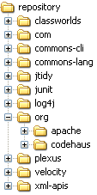
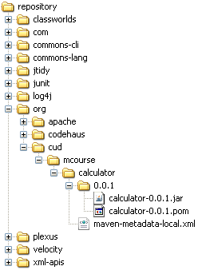
Задача install:install

Slide 20
Задача clean:clean
I:\project>mvn clean:clean
[INFO] Scanning for projects...
[INFO] Searching repository for plugin with prefix: 'clean'.
[INFO] ------------------------------------------------------------------------
[INFO] Building calculator
[INFO] task-segment: [clean:clean]
[INFO] ------------------------------------------------------------------------
[INFO] [clean:clean {execution: default-cli}]
[INFO] Deleting directory I:\project\target
[INFO] ------------------------------------------------------------------------
[INFO] BUILD SUCCESSFUL
[INFO] ------------------------------------------------------------------------
[INFO] Total time: < 1 second
[INFO] Finished at: Tue Jun 18 15:41:06 GMT+07:00 2013
[INFO] Final Memory: 3M/15M
[INFO] ------------------------------------------------------------------------
I:\project>
[INFO] Deleting directory I:\project\target

Slide 21
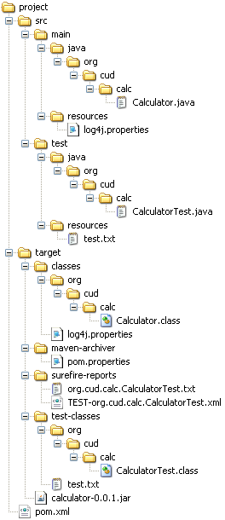

Задача clean:clean

Slide 22
Сборка проекта

Slide 23
Сборка проекта
 | У Maven есть три цикла сборки : default, clean и site. Каждый из циклов состоит из последовательности фаз. Можно сразу же вызывать любую фазу любого цикла. В этом случае будут по очереди выполняться задачи зарегистрированные у всех фаз в цикле до этой фазы после чего будут выполнены задачи вызванной фазы.

Slide 24
Фаза install
I:\project>mvn install
[INFO] Scanning for projects...
[INFO] ------------------------------------------------------------------------
[INFO] Building calculator
[INFO] task-segment: [install]
[INFO] ------------------------------------------------------------------------
[INFO] [resources:resources {execution: default-resources}]
[INFO] Using 'UTF-8' encoding to copy filtered resources.
[INFO] Copying 1 resource
[INFO] [compiler:compile {execution: default-compile}]
[INFO] Compiling 1 source file to I:\project\target\classes
[INFO] [resources:testResources {execution: default-testResources}]
[INFO] Using 'UTF-8' encoding to copy filtered resources.
[INFO] Copying 1 resource
[INFO] [compiler:testCompile {execution: default-testCompile}]
[INFO] Compiling 1 source file to I:\project\target\test-classes
[INFO] [surefire:test {execution: default-test}]
[INFO] Surefire report directory: I:\project\target\surefire-reports
...
Tests run: 1, Failures: 0, Errors: 0, Skipped: 0
[INFO] [jar:jar {execution: default-jar}]
[INFO] Building jar: I:\project\target\calculator-0.0.1.jar
[INFO] [install:install {execution: default-install}]
[INFO] Installing I:\project\target\calculator-0.0.1.jar to C:\Documents and Settings\Administrator\.m2\repository\org\cud\mcourse\calculator\0.0.1\calculator-0.0.1.jar
[INFO] ------------------------------------------------------------------------
[INFO] BUILD SUCCESSFUL
[INFO] ------------------------------------------------------------------------
[INFO] Total time: 2 seconds
[INFO] Finished at: Tue Jun 18 15:34:23 GMT+07:00 2013
[INFO] Final Memory: 15M/36M
[INFO] ------------------------------------------------------------------------
I:\project>
[INFO] Copying 1 resource
[INFO] Compiling 1 source file to I:\project\target\classes
[INFO] Copying 1 resource
[INFO] Compiling 1 source file to I:\project\target\test-classes
[INFO] Building jar: I:\project\target\calculator-0.0.1.jar
[INFO] Installing I:\project\target\calculator-0.0.1.jar to C:\Documents and Settings\Administrator\.m2\repository\org\cud\mcourse\calculator\0.0.1\calculator-0.0.1.jar

Slide 25
Фаза install

Slide 26
Фаза clean
I:\project>mvn clean
[INFO] Scanning for projects...
[INFO] ------------------------------------------------------------------------
[INFO] Building calculator
[INFO] task-segment: [clean]
[INFO] ------------------------------------------------------------------------
[INFO] [clean:clean {execution: default-clean}]
[INFO] Deleting directory I:\project\target
[INFO] ------------------------------------------------------------------------
[INFO] BUILD SUCCESSFUL
[INFO] ------------------------------------------------------------------------
[INFO] Total time: < 1 second
[INFO] Finished at: Tue Jun 18 15:39:43 GMT+07:00 2013
[INFO] Final Memory: 3M/15M
[INFO] ------------------------------------------------------------------------
I:\project>
[INFO] Deleting directory I:\project\target

Slide 27
Фаза clean

Slide 28
Настройка плагинов и задач по умолчанию
<plugin>
<artifactId>maven-resources-plugin</artifactId>
<version>2.5</version>
<executions>
<execution>
<id>default-resources</id>
<phase>process-resources</phase>
<goals>
<goal>resources</goal>
</goals>
</execution>
<execution>
<id>default-testResources</id>
<phase>process-test-resources</phase>
<goals>
<goal>testResources</goal>
</goals>
</execution>
</executions>
</plugin>
<plugin>
<artifactId>maven-install-plugin</artifactId>
<version>2.3.1</version>
<executions>
<execution>
<id>default-install</id>
<phase>install</phase>
<goals>
<goal>install</goal>
</goals>
</execution>
</executions>
</plugin>
<plugin>
<artifactId>maven-surefire-plugin</artifactId>
<version>2.10</version>
<executions>
<execution>
<id>default-test</id>
<phase>test</phase>
<goals>
<goal>test</goal>
</goals>
</execution>
</executions>
</plugin>
resources
install
test
<plugin>
<artifactId>maven-compiler-plugin</artifactId>
<version>2.3.2</version>
<executions>
<execution>
<id>default-testCompile</id>
<phase>test-compile</phase>
<goals>
<goal>testCompile</goal>
</goals>
</execution>
<execution>
<id>default-compile</id>
<phase>compile</phase>
<goals>
<goal>compile</goal>
</goals>
</execution>
</executions>
</plugin>
<plugin>
<artifactId>maven-jar-plugin</artifactId>
<version>2.3.2</version>
<executions>
<execution>
<id>default-jar</id>
<phase>package</phase>
<goals>
<goal>jar</goal>
</goals>
</execution>
</executions>
</plugin>
<plugin>
<artifactId>maven-deploy-plugin</artifactId>
<version>2.7</version>
<executions>
<execution>
<id>default-deploy</id>
<phase>deploy</phase>
<goals>
<goal>deploy</goal>
</goals>
</execution>
</executions>
</plugin>
testCompile
jar
deploy
compile

Slide 29
Получение информации о цикле default
I:\project>mvn help:describe -Dcmd=install
...
[INFO] [help:describe {execution: default-cli}]
[INFO] 'install' is a phase corresponding to this plugin:
org.apache.maven.plugins:maven-install-plugin:install
It is a part of the lifecycle for the POM packaging 'jar'. This lifecycle includes the following phases:
* validate: Not defined
* initialize: Not defined
* generate-sources: Not defined
* process-sources: Not defined
* generate-resources: Not defined
* process-resources: org.apache.maven.plugins:maven-resources-plugin:resources
* compile: org.apache.maven.plugins:maven-compiler-plugin:compile
* process-classes: Not defined
* generate-test-sources: Not defined
* process-test-sources: Not defined
* generate-test-resources: Not defined
* process-test-resources: org.apache.maven.plugins:maven-resources-plugin:testResources
* test-compile: org.apache.maven.plugins:maven-compiler-plugin:testCompile
* process-test-classes: Not defined
* test: org.apache.maven.plugins:maven-surefire-plugin:test
* prepare-package: Not defined
* package: org.apache.maven.plugins:maven-jar-plugin:jar
* pre-integration-test: Not defined
* integration-test: Not defined
* post-integration-test: Not defined
* verify: Not defined
* install: org.apache.maven.plugins:maven-install-plugin:install
* deploy: org.apache.maven.plugins:maven-deploy-plugin:deploy
[INFO] ------------------------------------------------------------------------
[INFO] BUILD SUCCESSFUL
[INFO] ------------------------------------------------------------------------
...
I:\project>

Slide 30
Получение информации о цикле clean
I:\project>mvn help:describe -Dcmd=clean
[INFO] Scanning for projects...
[INFO] Searching repository for plugin with prefix: 'help'.
[INFO] ------------------------------------------------------------------------
[INFO] Building calculator
[INFO] task-segment: [help:describe] (aggregator-style)
[INFO] ------------------------------------------------------------------------
[INFO] [help:describe {execution: default-cli}]
[INFO] 'clean' is a lifecycle with the following phases:
* pre-clean: Not defined
* clean: org.apache.maven.plugins:maven-clean-plugin:clean
* post-clean: Not defined
[INFO] ------------------------------------------------------------------------
[INFO] BUILD SUCCESSFUL
[INFO] ------------------------------------------------------------------------
[INFO] Total time: 1 second
[INFO] Finished at: Tue Jun 18 15:48:50 GMT+07:00 2013
[INFO] Final Memory: 11M/26M
[INFO] ------------------------------------------------------------------------
I:\project>

Slide 31
Изменение цикла сборки

Slide 32
Регистрация и настройка плагинов и задач в pom
<project>
<modelVersion>4.0.0</modelVersion>
<!-- Build Settings -->
<build>...</build>
</project>
<build>...</build>

Slide 33
Регистрация плагинов и задач
<build>
...
<plugins>
<plugin>
<artifactId> ... </artifactId>
<version> ... </version>
<executions>
<execution>
<id> ... </id>
<phase> ... </phase>
<goals>
<goal> ... </goal>
</goals>
<configuration>
...
</configuration>
</execution>
</executions>
<configuration>
...
</configuration>
</plugin>
</plugins>
</build>
 | Можно задать параметры для всех задач плагина. Можно привязать задачу плагина к фазе и для выполнения этой задачи задать параметры.

Slide 34
Конфигурация всех задач плагина

Slide 35
Конфигурация всех задач плагина
<build>
<plugins>
<plugin>
<groupId>org.apache.maven.plugins</groupId>
<artifactId>maven-jar-plugin</artifactId>
<configuration>
<archive>
<manifest>
<mainClass>org.cud.mavencourse.App</mainClass>
<addClasspath>true</addClasspath>
</manifest>
</archive>
</configuration>
</plugin>
</plugins>
</build>
<manifest>
<mainClass>org.cud.mavencourse.App</mainClass>
<addClasspath>true</addClasspath>
</manifest>

Slide 36
Конфигурация всех задач плагина
I:\project>mvn package -DskipTests=true
[INFO] Scanning for projects...
[INFO] ------------------------------------------------------------------------
[INFO] Building calculator
[INFO] task-segment: [package]
[INFO] ------------------------------------------------------------------------
[INFO] [resources:resources {execution: default-resources}]
[INFO] Using 'UTF-8' encoding to copy filtered resources.
[INFO] Copying 1 resource
[INFO] [compiler:compile {execution: default-compile}]
[INFO] Nothing to compile - all classes are up to date
[INFO] [resources:testResources {execution: default-testResources}]
[INFO] Using 'UTF-8' encoding to copy filtered resources.
[INFO] Copying 1 resource
[INFO] [compiler:testCompile {execution: default-testCompile}]
[INFO] Nothing to compile - all classes are up to date
[INFO] [surefire:test {execution: default-test}]
[INFO] Tests are skipped.
[INFO] [jar:jar {execution: default-jar}]
[INFO] ------------------------------------------------------------------------
[INFO] BUILD SUCCESSFUL
[INFO] ------------------------------------------------------------------------
[INFO] Total time: 1 second
[INFO] Finished at: Tue Jun 18 16:20:50 GMT+07:00 2013
[INFO] Final Memory: 9M/21M
[INFO] ------------------------------------------------------------------------
I:\project>cd target
I:\project\target>java -jar calculator-0.0.1.jar 1 2 3 4 5
Hello Calculator
2+3+4 = 9
I:\project\target>
java -jar calculator-0.0.1.jar 1 2 3 4 5

Slide 37
Конфигурация всех задач плагина
I:\project>mvn compiler:compile
[INFO] Scanning for projects...
[INFO] ------------------------------------------------------------------------
[INFO] Building calculator
[INFO] task-segment: [compiler:compile]
[INFO] ------------------------------------------------------------------------
[INFO] [compiler:compile {execution: default-cli}]
[INFO] Compiling 2 source files to I:\project\target\classes
[INFO] ------------------------------------------------------------------------
[INFO] BUILD SUCCESSFUL
[INFO] ------------------------------------------------------------------------
[INFO] Total time: < 1 second
[INFO] Finished at: Tue Jun 18 16:25:24 GMT+07:00 2013
[INFO] Final Memory: 5M/15M
[INFO] ------------------------------------------------------------------------
I:\project>mvn jar:jar
[INFO] Scanning for projects...
[INFO] ------------------------------------------------------------------------
[INFO] Building calculator
[INFO] task-segment: [jar:jar]
[INFO] ------------------------------------------------------------------------
[INFO] [jar:jar {execution: default-cli}]
[INFO] Building jar: I:\project\target\calculator-0.0.1.jar
[INFO] ------------------------------------------------------------------------
[INFO] BUILD SUCCESSFUL
[INFO] ------------------------------------------------------------------------
[INFO] Total time: < 1 second
[INFO] Finished at: Tue Jun 18 16:25:28 GMT+07:00 2013
[INFO] Final Memory: 4M/15M
[INFO] ------------------------------------------------------------------------
I:\project>cd target
I:\project\target>java -jar calculator-0.0.1.jar 1 2 3 4 5
Hello Calculator
2+3+4 = 9
I:\project\target>
java -jar calculator-0.0.1.jar 1 2 3 4 5

Slide 38
Конфигурация конкретного выполнения

Slide 39
Конфигурация конкретного выполнения
<build>
<plugins>
<plugin>
<groupId>org.apache.maven.plugins</groupId>
<artifactId>maven-jar-plugin</artifactId>
<executions>
<execution>
<id>default-jar</id>
<phase>compile</phase>
<goals>
<goal>jar</goal>
</goals>
<configuration>
<archive>
<manifest>
<mainClass>org.cud.mavencourse.App</mainClass>
<addClasspath>true</addClasspath>
</manifest>
</archive>
</configuration>
</execution>
</executions>
</plugin>
</plugins>
</build>
<manifest>
<mainClass>org.cud.mavencourse.App</mainClass>
<addClasspath>true</addClasspath>
</manifest>

Slide 40
Конфигурация конкретного выполнения
I:\project>mvn package -DskipTests=true
[INFO] Scanning for projects...
[INFO] ------------------------------------------------------------------------
[INFO] Building calculator
[INFO] task-segment: [package]
[INFO] ------------------------------------------------------------------------
[INFO] [resources:resources {execution: default-resources}]
[INFO] Using 'UTF-8' encoding to copy filtered resources.
[INFO] Copying 1 resource
[INFO] [compiler:compile {execution: default-compile}]
[INFO] Compiling 2 source files to I:\project\target\classes
[INFO] [resources:testResources {execution: default-testResources}]
[INFO] Using 'UTF-8' encoding to copy filtered resources.
[INFO] Copying 1 resource
[INFO] [compiler:testCompile {execution: default-testCompile}]
[INFO] Compiling 1 source file to I:\project\target\test-classes
[INFO] [surefire:test {execution: default-test}]
[INFO] Tests are skipped.
[INFO] [jar:jar {execution: default-jar}]
[INFO] Building jar: I:\project\target\calculator-0.0.1.jar
[INFO] ------------------------------------------------------------------------
[INFO] BUILD SUCCESSFUL
[INFO] ------------------------------------------------------------------------
[INFO] Total time: 2 seconds
[INFO] Finished at: Tue Jun 18 16:28:05 GMT+07:00 2013
[INFO] Final Memory: 14M/34M
[INFO] ------------------------------------------------------------------------
I:\project>cd target
I:\project\target>java -jar calculator-0.0.1.jar 1 2 3 4 5
Failed to load Main-Class manifest attribute from
calculator-0.0.1.jar
I:\project\target>
java -jar calculator-0.0.1.jar 1 2 3 4 5

Slide 41
Регистрация задачи у фазы

Slide 42
Регистрация задачи у фазы
<project...>
<modelVersion>4.0.0</modelVersion>
<groupId>org.cud.mcourse</groupId>
<artifactId>calculator</artifactId>
<version>0.1</version>
<packaging>jar</packaging>
<scm>
<connection>scm:svn:http://127.0.0.1/dummy</connection>
</scm>
<build>
<plugins>
<plugin>
<groupId>org.codehaus.mojo</groupId>
<artifactId>buildnumber-maven-plugin</artifactId>
<version>1.2</version>
<executions>
<execution>
<phase>validate</phase>
<goals>
<goal>create</goal>
</goals>
</execution>
</executions>
<configuration>
<format>${version}.{0,number}</format>
<items>
<item>buildNumber</item>
</items>
</configuration>
</plugin>
</plugins>
<finalName> ${project.artifactId}-${buildNumber} </finalName>
</build>
</project>

Slide 43
Конфигурация конкретного выполнения
I:\project>mvn -f registr_pom.xml package -DskipTests=true
[INFO] Scanning for projects...
[INFO] ------------------------------------------------------------------------
[INFO] Building calculator
[INFO] task-segment: [package]
[INFO] ------------------------------------------------------------------------
[INFO] [buildnumber:create {execution: default}]
[INFO] Storing buildNumber: 0.1.1 at timestamp: 1371548695250
[INFO] Executing: cmd.exe /X /C "svn --non-interactive info"
[INFO] Working directory: I:\project
[INFO] Storing buildScmBranch: UNKNOWN_BRANCH
[INFO] [resources:resources {execution: default-resources}]
[INFO] Using 'UTF-8' encoding to copy filtered resources.
[INFO] Copying 1 resource
[INFO] [compiler:compile {execution: default-compile}]
[INFO] Nothing to compile - all classes are up to date
[INFO] [resources:testResources {execution: default-testResources}]
[INFO] Using 'UTF-8' encoding to copy filtered resources.
[INFO] Copying 1 resource
[INFO] [compiler:testCompile {execution: default-testCompile}]
[INFO] Nothing to compile - all classes are up to date
[INFO] [surefire:test {execution: default-test}]
[INFO] Tests are skipped.
[INFO] [jar:jar {execution: default-jar}]
[INFO] Building jar: I:\project\target\calculator-0.1.1.jar
[INFO] ------------------------------------------------------------------------
[INFO] BUILD SUCCESSFUL
[INFO] ------------------------------------------------------------------------
[INFO] Total time: 2 seconds
[INFO] Finished at: Tue Jun 18 16:44:55 GMT+07:00 2013
[INFO] Final Memory: 14M/34M
[INFO] ------------------------------------------------------------------------
[INFO] Building jar: I:\project\target\calculator-0.1.1.jar

Slide 44
Конфигурация конкретного выполнения
I:\project>mvn -f registr_pom.xml package -DskipTests=true
[INFO] Scanning for projects...
[INFO] ------------------------------------------------------------------------
[INFO] Building calculator
[INFO] task-segment: [package]
[INFO] ------------------------------------------------------------------------
[INFO] [buildnumber:create {execution: default}]
[INFO] Storing buildNumber: 0.1.2 at timestamp: 1371548702546
[INFO] Executing: cmd.exe /X /C "svn --non-interactive info"
[INFO] Working directory: I:\project
[INFO] Storing buildScmBranch: UNKNOWN_BRANCH
[INFO] [resources:resources {execution: default-resources}]
[INFO] Using 'UTF-8' encoding to copy filtered resources.
[INFO] Copying 1 resource
[INFO] [compiler:compile {execution: default-compile}]
[INFO] Nothing to compile - all classes are up to date
[INFO] [resources:testResources {execution: default-testResources}]
[INFO] Using 'UTF-8' encoding to copy filtered resources.
[INFO] Copying 1 resource
[INFO] [compiler:testCompile {execution: default-testCompile}]
[INFO] Nothing to compile - all classes are up to date
[INFO] [surefire:test {execution: default-test}]
[INFO] Tests are skipped.
[INFO] [jar:jar {execution: default-jar}]
[INFO] Building jar: I:\project\target\calculator-0.1.2.jar
[INFO] ------------------------------------------------------------------------
[INFO] BUILD SUCCESSFUL
[INFO] ------------------------------------------------------------------------
[INFO] Total time: 2 seconds
[INFO] Finished at: Tue Jun 18 16:45:03 GMT+07:00 2013
[INFO] Final Memory: 14M/34M
[INFO] ------------------------------------------------------------------------
I:\project>
[INFO] Building jar: I:\project\target\calculator-0.1.2.jar

